Slide 1
Synthetic Aperture Radar Imager
ECE Team 7
MEMBERS:
SCOTT NICEWONGER
KEGAN STACK
OLIVIER BARBIER
JULIAN RODRIGUEZ
JORDAN BOLDUC
SPONSOR: NORTHROP GRUMMAN
CONTACT: PETE STENGER
ADVISORS: DR. SIMON FOO
DR. SHONDA BERNADIN
INSTRUCTOR: DR. JERRIS HOOKER
DATE: 10/23/2015

Slide 2
Outline
Scott Nicewonger
  Project Overview
  Current Status
  Goals And Objectives
  Gantt Chart & Future Plans
Jordan Bolduc
  Scope
  Customer Needs (Electrical)
  Image Formation
Olivier Barbier
  FPGA Software Top-down
  Software Development
Julian Rodriguez
  Current Status (Mechanical)
  Challenges & Considerations
Kegan Stack
  Mechanical Design Concepts

Slide 3
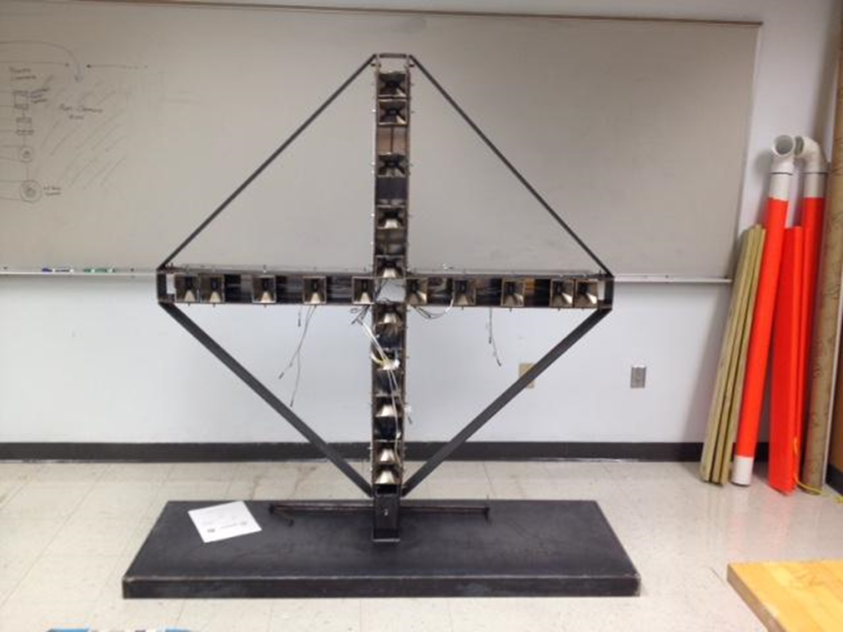
  Project Overview
  Current Status
  Goals and Objectives
SCOTT NICEWONGER

Slide 4
PROJECT OVERVIEW
QUESTION: How can we use technology to enhance physical security at our most vulnerable infrastructure targets?
Some Current Solutions:
  Metal detectors
  Millimeter wave full-body scanners
Backscatter x-ray scanners
    Banned in EU in 2012 for ionizing radiation
    Banned for TSA in 2013 for privacy software non-compliance
All have one thing in common:
Subjects must step inside an apparatus to be scanned!

Slide 5
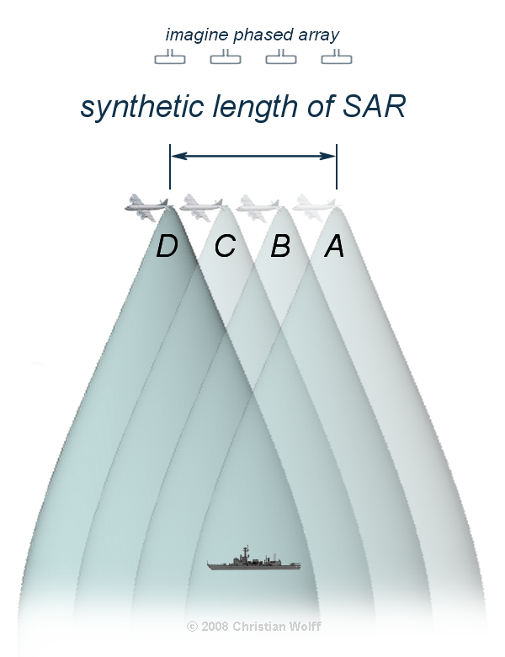
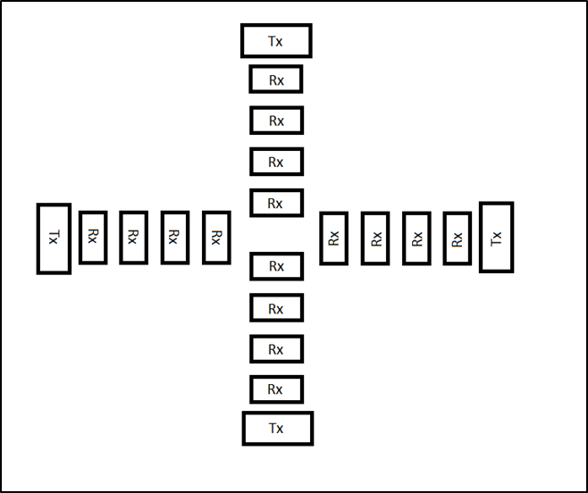
Synthetic Aperture Radar (SAR) Imager
THE SOLUTION = SAR IMAGER
Uses low-powered X-band Radio Frequency (RF) to image objects from a distance (20 feet)
RF Exposure Safety Guidelines
  ANSI/IEEE C95.1-1992
  FCC 47 C.F.R. 1.1307(b), 1.1310, 2.1091, 2.1093
Limit for human exposure: 1 mW/cm²
SAR Peak Transmit: 0.0076 mW/cm²

Slide 6
  Application Example
SAR as Standalone First-layer Physical Security Measure

Slide 7
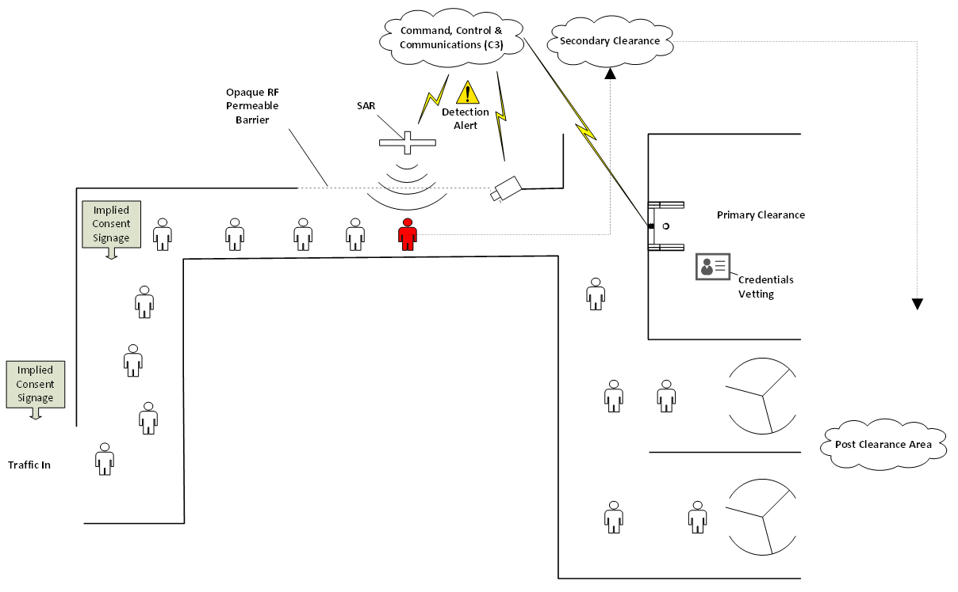

Slide 8
CURRENT STATUS (ELECTRICAL)
2014 team successfully transmitted and received a 20 ns wide RF pulsed signal at 10 GHz
Demonstration was achieved using external signal source and external pulse generator
Transmit / Receive Mode & pulse switching capability inoperable
Signal Processing not implemented
Image display not implemented

Slide 9
Goals and Objectives for 2015
Verify Electrical System
  Complete up to Test Plan FA15-TXIF-004 by mid November
  Full functionality of TX chain by end of semester
Optimize FPGA Programing
  Comment, debug, & streamline what’s salvageable from last year’s code by mid November
FPGA Software Development
  Pseudocode for new code by mid November
Re-design Mechanical Structure
  Optimize for weight, maneuverability and stability (ME Team 18 leading)
      Target weight: 80lbs
  Minimize cost
      Less than $5,000 for full re-design (ME Team 18 & ECE Team 7)
  Final design proposal by second week in November (ME Team 18 leading)

Slide 10
  Scope and Prototype
  Customer Needs and Product Specs (Electrical)
  Image Formation
JORDAN BOLDUC

Slide 11
SCOPE
Last year initial design. This year focus on full functionality and optimization.
FPGA board must control timing, switching, and drive voltage-controlled oscillator
Broad range of topics covered:
  Signal Processing Techniques (Fourier Transform)
  Electromagnetic Pulse Propagation
  VHDL coding and how to operate other techniques through VHDL.
  Noise Considerations

Slide 12
CUSTOMER NEEDS AND PRODUCT SPECIFICATIONS
Customer is Northrop Grumman, who needs a working prototype
Requires that the Imager is fully functional, both transmit and receive
No more need for test signals, must be controlled solely from FPGA
Must identify target from a scene 20 feet away
Scene being targeted is 40” by 40”
Solid State switches functionality
VGA display
10 GHz operating Frequency

Slide 13
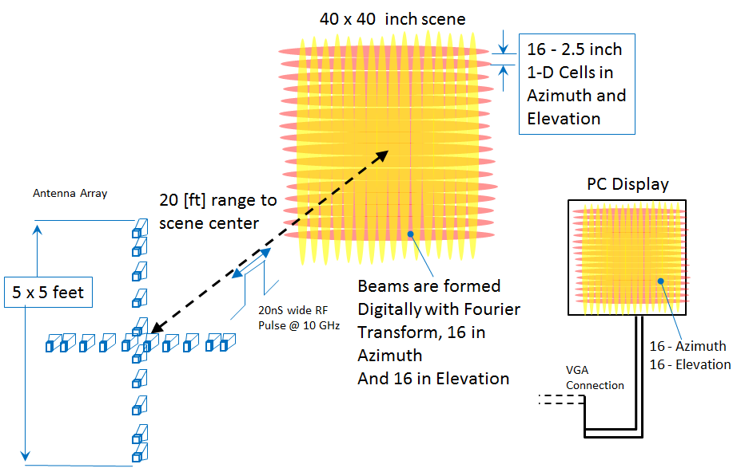


Slide 14
  FPGA
  Software Top-Down Functional Diagram
  Software Development
OLIVIER BARBIER

Slide 15
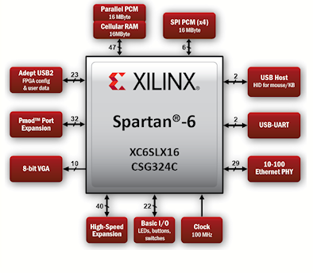
FPGA
Using XILINX FPGA
  More expensive than similar Altera board
  Why?
    100MHz clock frequency
    Basic math logic module
    Analog-to-digital and digital-to-analog converter.
    Capabilities of Image Processing
Main Objectives
    Generate signals to control different components
    Store values and do signal processing calculations
    Send what need to be display.

Slide 16
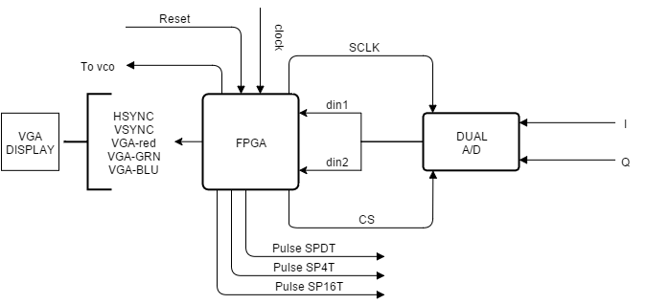
Software Top-Down Functional Diagram

Slide 17
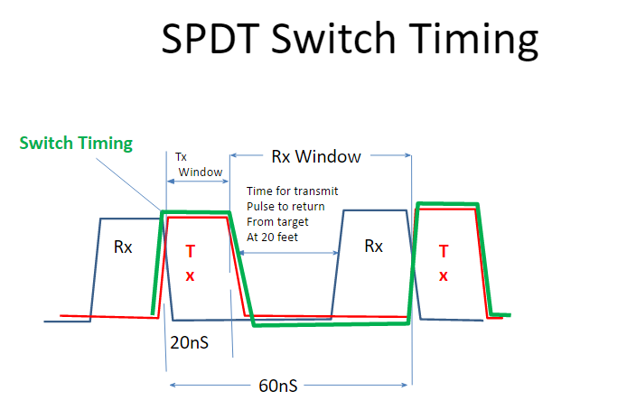
SOFTWARE DEVELOPMENT
What we need to do
  Understanding and testing last year team code
  Verify & Optimize code
    System Timing
    A/D conversion code
  VGA coding
    Develop and implement the VGA display algorithm and analysis of the signal from IQ demodulator
  Do parallel work on presenting detailed functional design modules and diagram of the different subprograms

Slide 18
  Current Status (Mechanical)
  Challenges & Design Considerations (Mechanical)
JULIAN RODRIGUEZ

Slide 19
Current State: Mechanical - Structure
Currently too heavy ~200lbs with component box (not pictured)
Structure is unstable and top heavy
Immobile and difficult to calibrate horns
Notes:
As of now, this is the prototype that last year’s team produced. Currently, this structure is over 200 pounds with the component box attached (not pictured). Although It is hard to get a grasp for the size of the structure in the image, the structure is tall enough to where it is considered top heavy and a slight bump or force exerted on the structure will cause it to wobble and shake. This instability directly affects the signal sent by the wave-guide by not allowing the RF signal to travel a direct trajectory. This is obviously not ideal and needs a complete structural redesign to optimize stability and weight. A further point of interest would be to increase the mobility of the prototype. As one can see from the image, there are no options from relocating the structure aside from lifting it however the weight also limits this capability. This limits the ease of calibration for the horns.

Slide 20
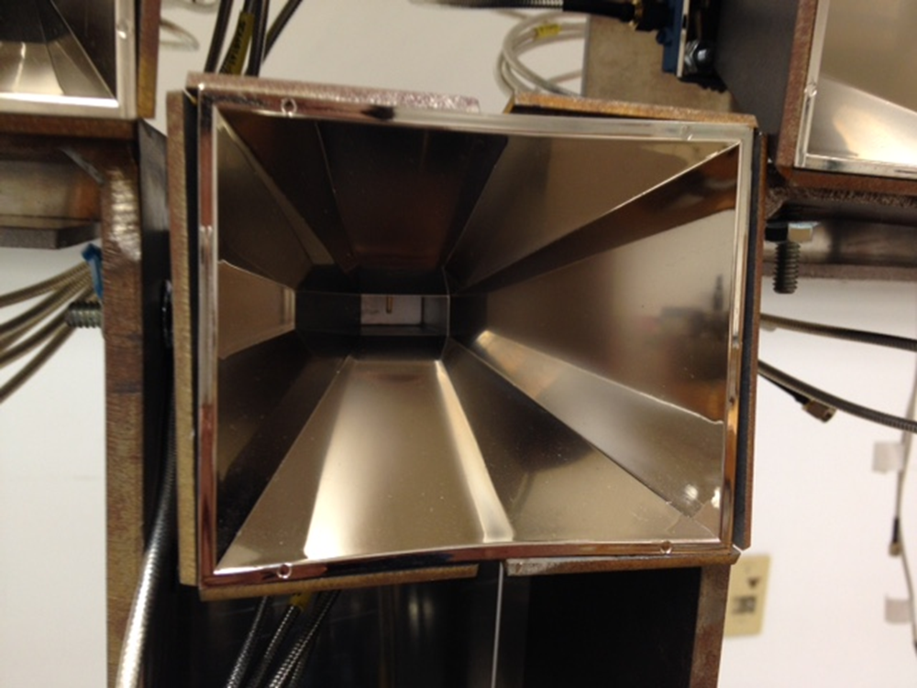
Current State: Mechanical - Horn Holders
Adjusting mechanism is not efficient
Shells are damaging the actual horns
Can only adjust rotation in one dimension
Notes:
For the current prototype, the horns sit within a shell and the way to calibrate the horns is through adjusting the rotation and then screwing down the shells to the structure. The flaw with this design is that since the shell must be screwed in place after a desired position has been selected, it is possible that the torque exerted onto the shell by the screw is enough to move the horn from its desired position. This adjusting mechanism must be redesigned to ensure accuracy in the horn placement. Another issue with this design is the shell that houses the horn have to tighten and in some cases are warping and damaging the actual horns, as shown in the image. This warping can also potentially distort the reading from the signal emitted by throwing off the trajectory for the signal. Furthermore, the horn’s must be able to rotate with 2 degrees of freedom azimuth and elevation for both horizontal and vertical arrays. This is optimal because having the ability to adjust the both angles will allow for easier calibration if an object is at a particular point in space relative to the front of the structure.

Slide 21
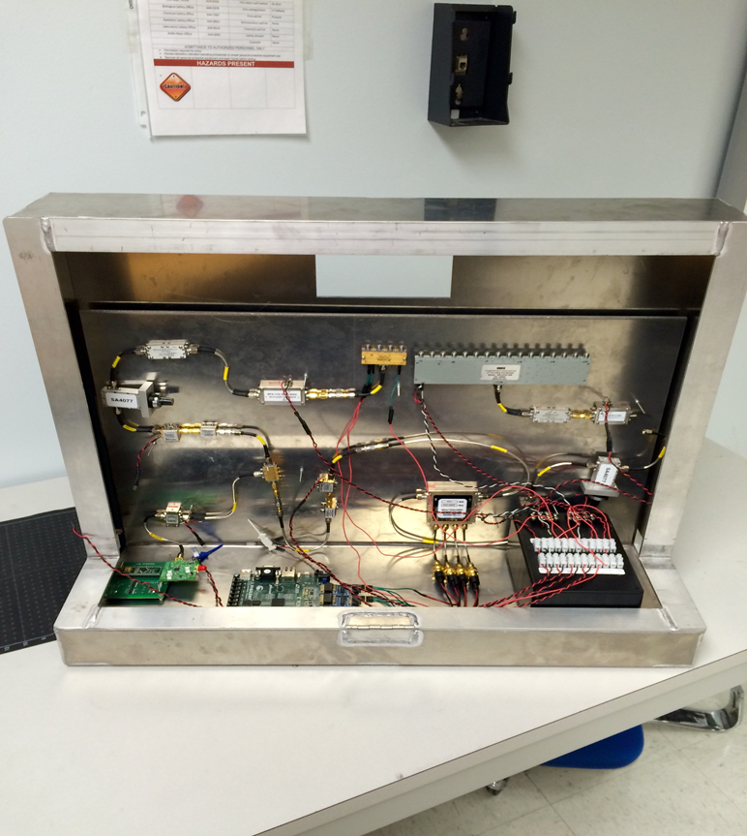
Current State: Mechanical - Component Box
Unnecessarily heavy and large
No locking mechanism, requires a more secure way to attach to the structure
Provides easy access to all components, yet can still improve on ergonomics
Notes:
The current component box, which houses all of the electrical hardware is a block of steel, unnecessarily large and heavy. There is no need for the large size because the electrical components do not take up that much space. For testing purposes the open space will be beneficial but another component box must be designed once the testing of the components is completed and a more minimal and streamline design can be modified to the new structure. The material selection can also vary because the heat generated by the electrical components is not significant enough to limit the design to metal. Other materials can be researched to decrease weight while still maintaining rigidity. In addition, there is no locking mechanism for attaching the component box to the actual structure. Currently, there are two slits on the structure in which the box slides into. This is not ideal since there is nothing aside from gravity securing the box in place. A better securing mechanism would greatly increase the safety and reliability of this design. Lastly, although the open space does make the testing easier, there is still room for improved ergonomics.

Slide 22
  Mechanical Design Concepts
KEGAN STACK

Slide 23
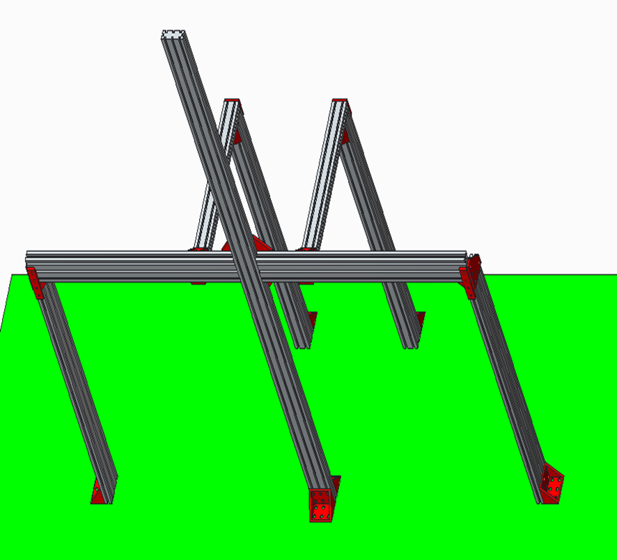
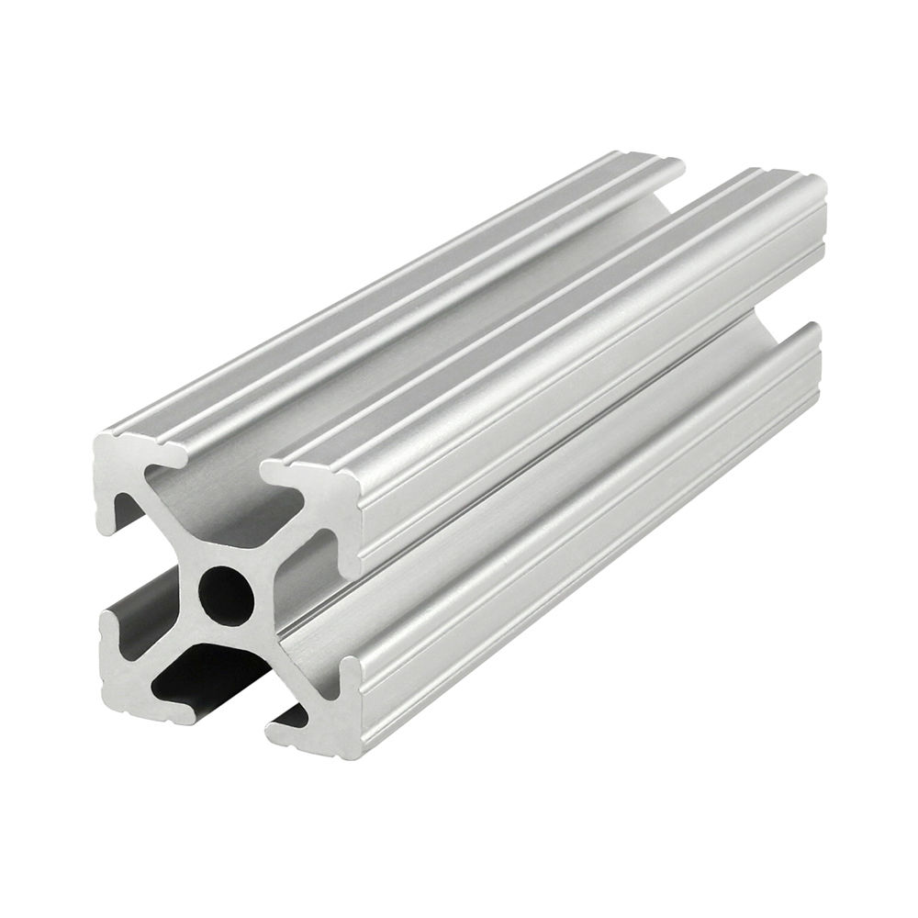
Design Concepts – Structure
Design A (80-20)

Slide 24
Concept Evaluation – Structure
PROS
CONS
COTS
Modular making it easy to assemble
Provides limitless translational horn placement along the beam
Lightweight compared to equivalent solid cross section
Many fasteners required
1/8” Fasteners might not carry weight or force well
Offers little waveguide/horn protection to the elements
Finite adjustments difficult

Slide 25
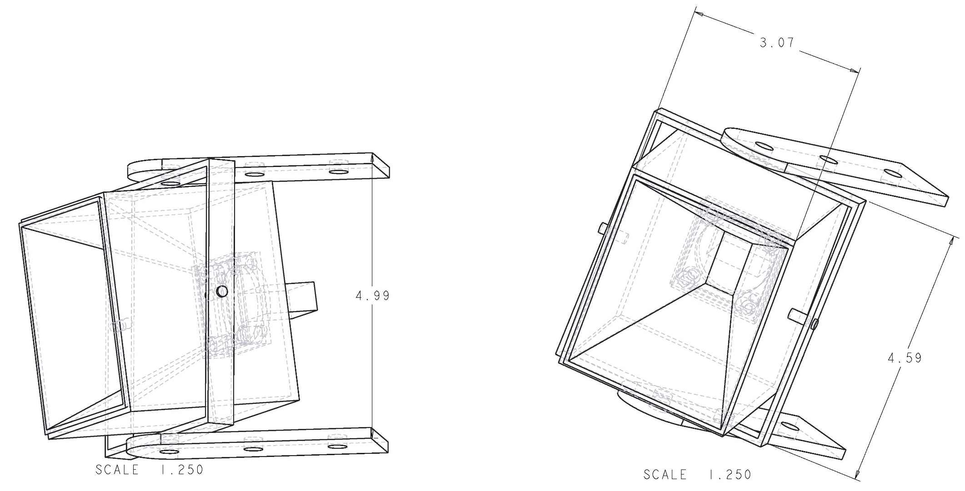
Design Concepts – Horn Holder
Design C (Covered Tilt)

Slide 26
Concepts Evaluation – Horn Holder
Pros
Pros
Cons
Cover allows for attachments (laser alignment)
Rotation about the center
Modeled in compatibility with 80/20 structures
Structure is quite complex
Cover may affect antenna readings

Slide 27
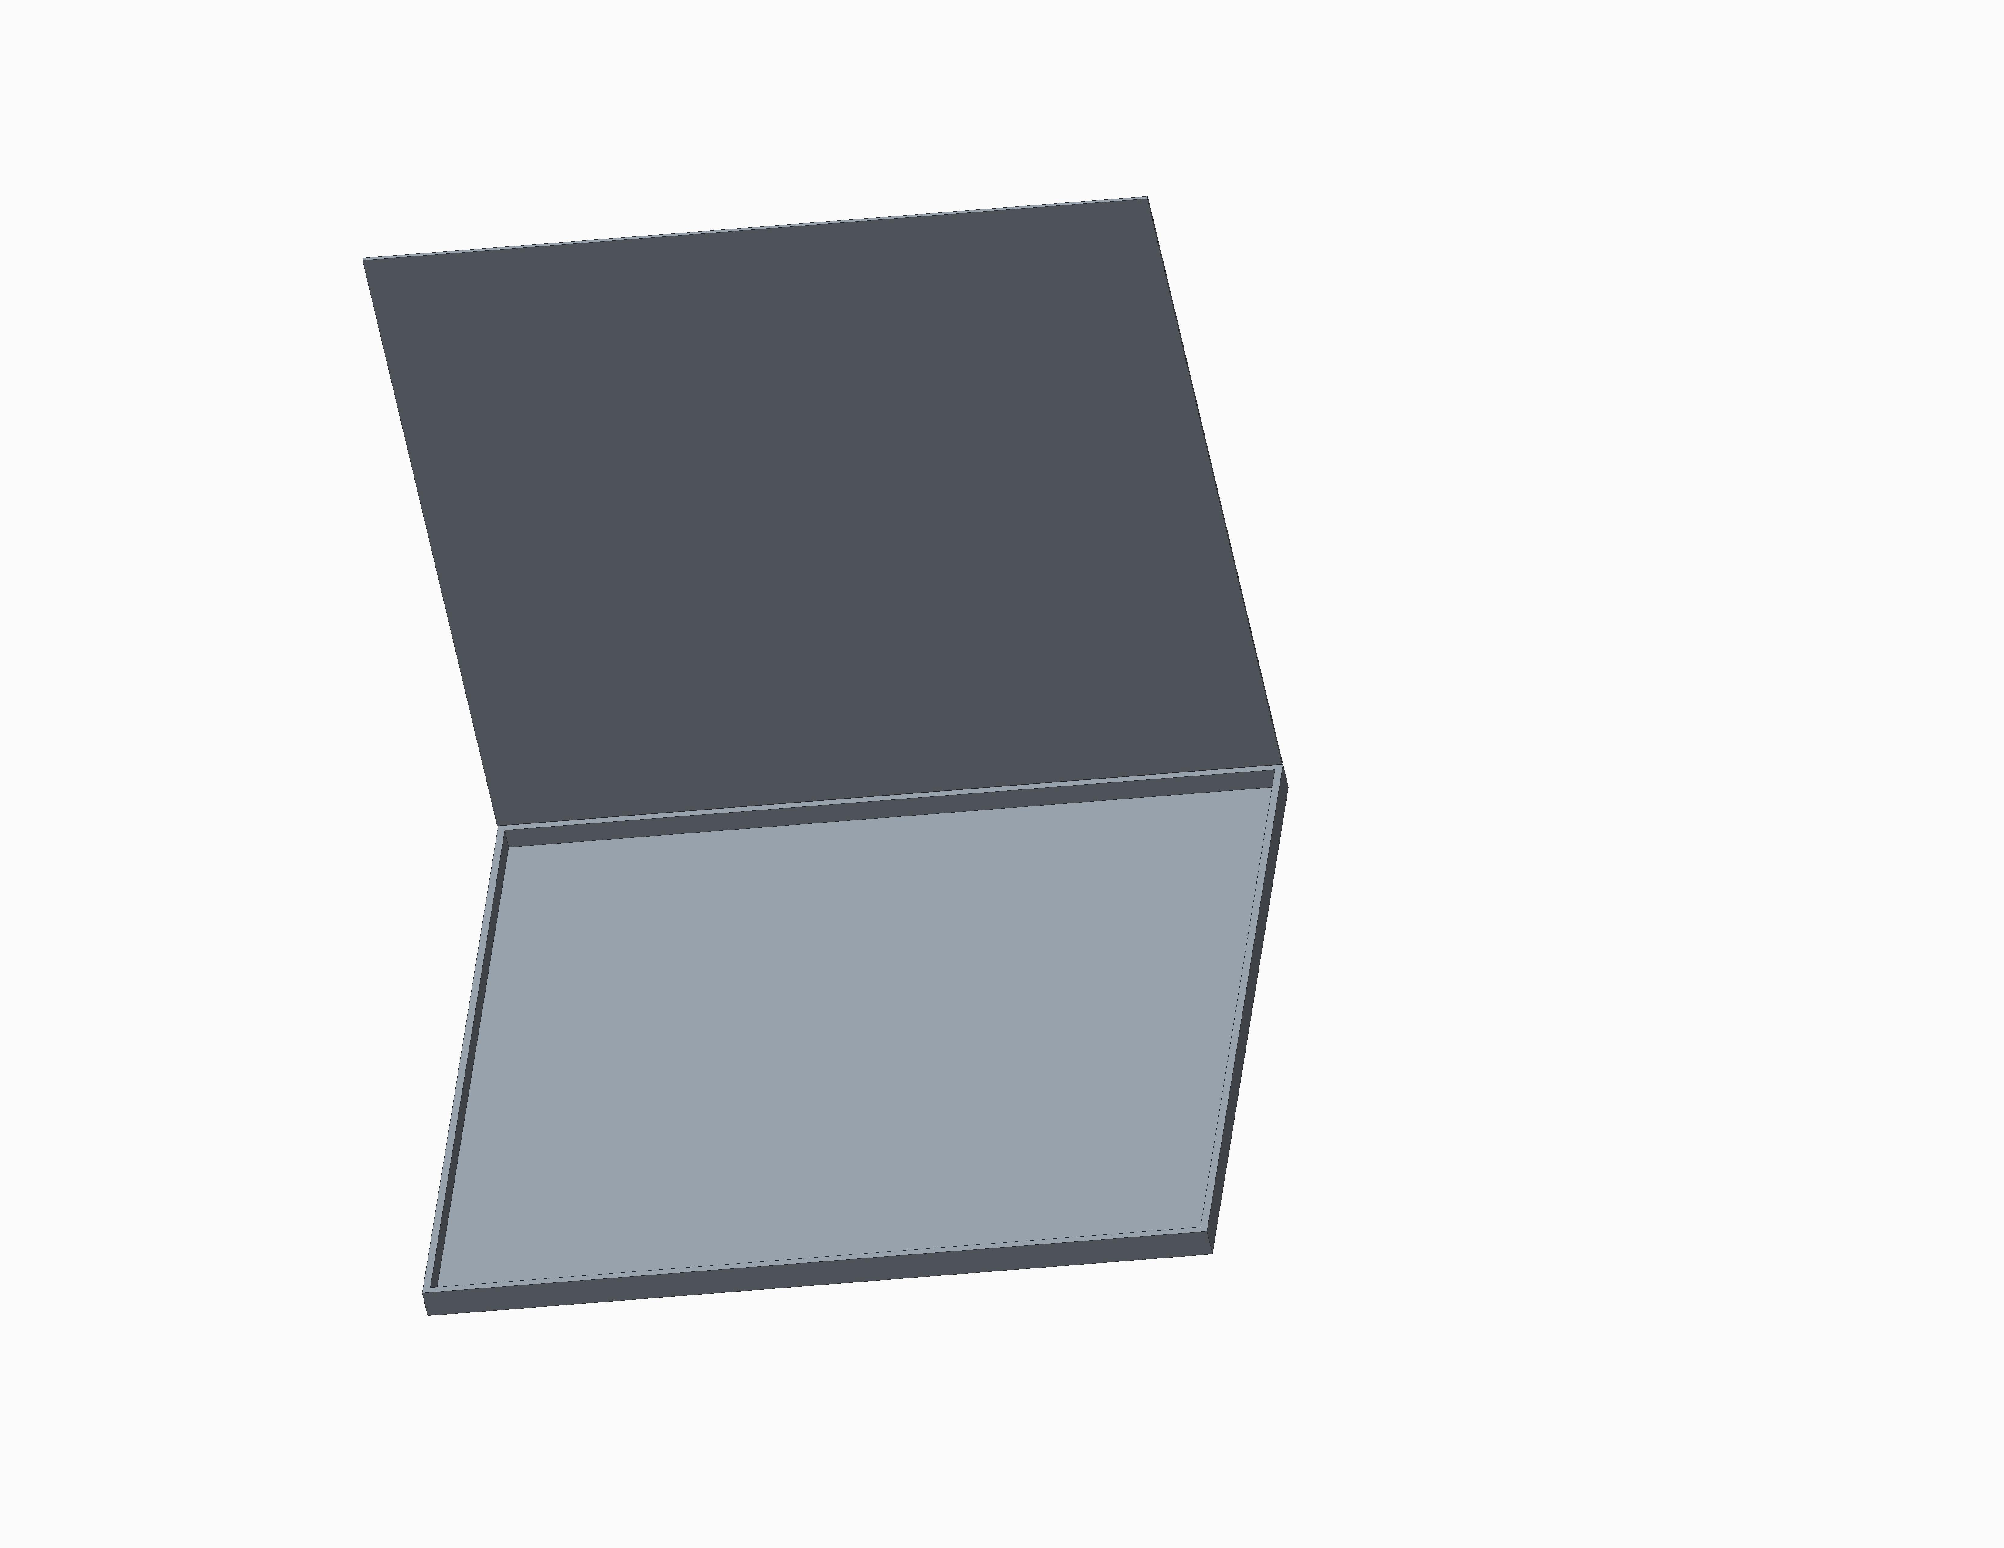
Component Box A
Pros
Allows easy access to all components
Light weight
Double as a table to set lap top on
Cons
May not allow proper cooling of components
Limits the spacing between rear support legs
27x24.75x2”

Slide 28
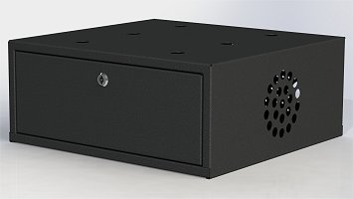
Component Box B
Pros
Lockable
Allows for a fan to be mounted
COTS
Cons
Heavier than previous design
Expensive
Limits the spacing of the rear support legs
21x20x9”

Slide 29
  Gantt Chart & Budget
SCOTT NICEWONGER

Slide 30
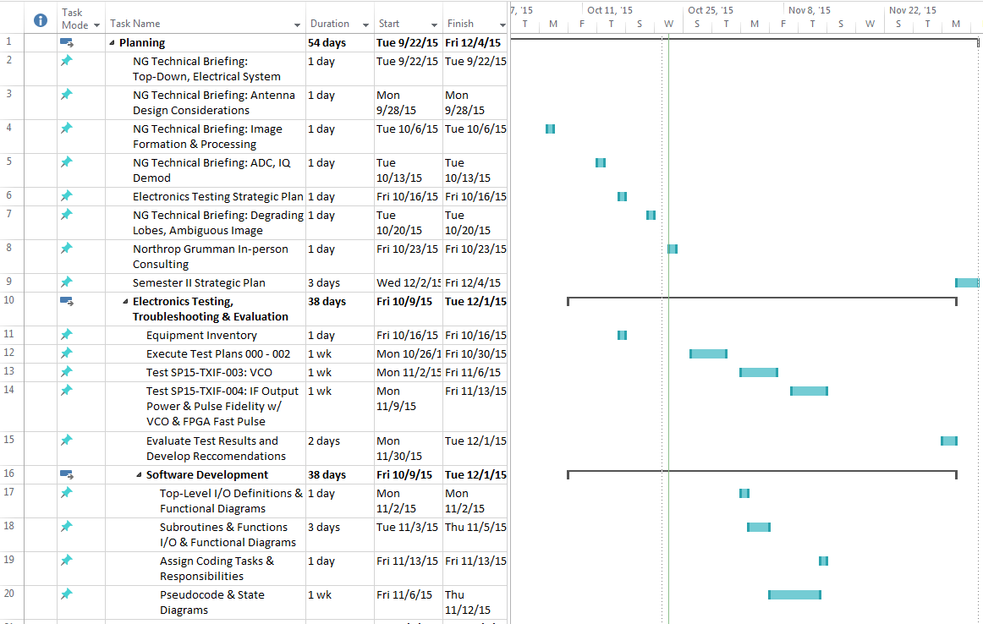
Gantt Chart

Slide 31
Budget
$ 10,000 Max for ECE Team 7
    $ 5,000 Base budget
    $ 5,000 Pool available upon formal request and department approval
$ 10,000 Max for ME Team 18
    $ 5,000 Base budget
    $ 5,000 Pool available upon formal request and department approval

Slide 32
SUMMARY
In this presentation we learned:
Project Overview
Applications
Design Principles and Considerations
Current Status
ECE & ME Goals

Slide 33
Questions?

Slide 34
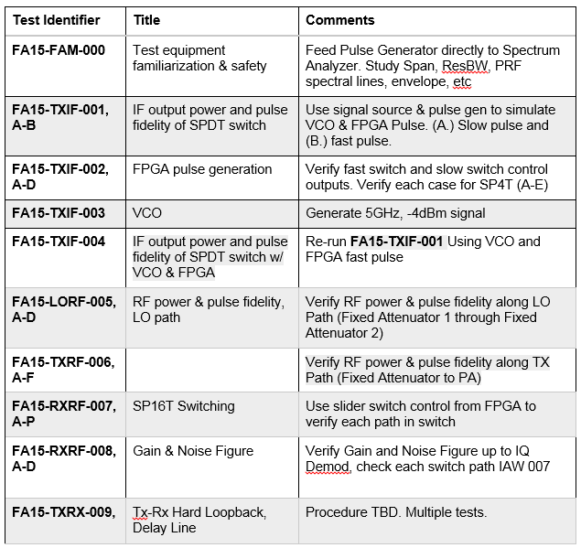
Table of Test Plans

Slide 35
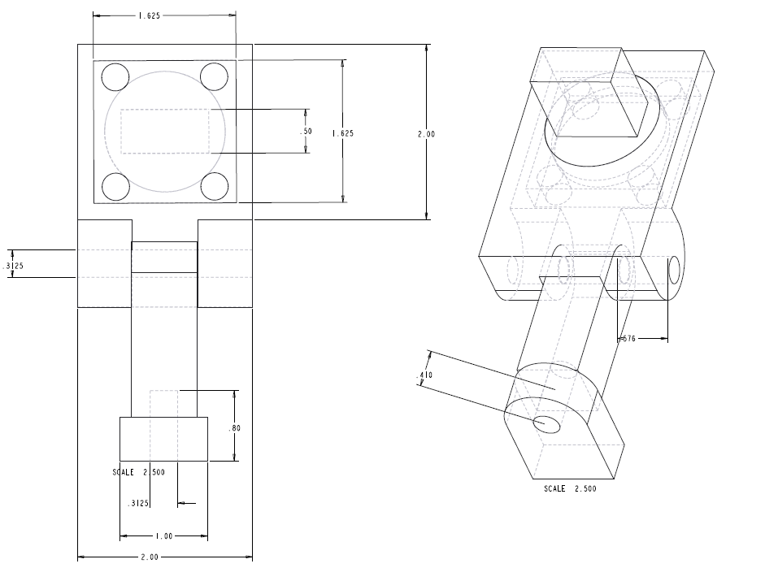
Design Concepts – Horn Holder
Design A (Articulating Arm)

Slide 36
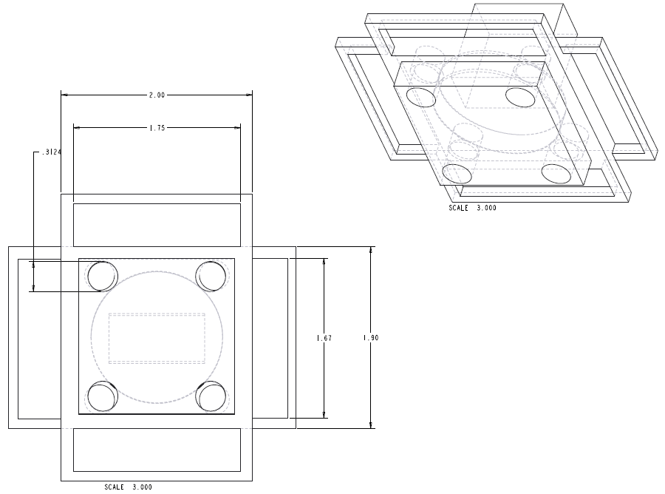
Design Concepts – Horn Holder
Design B (Handle Tilt)

Slide 37
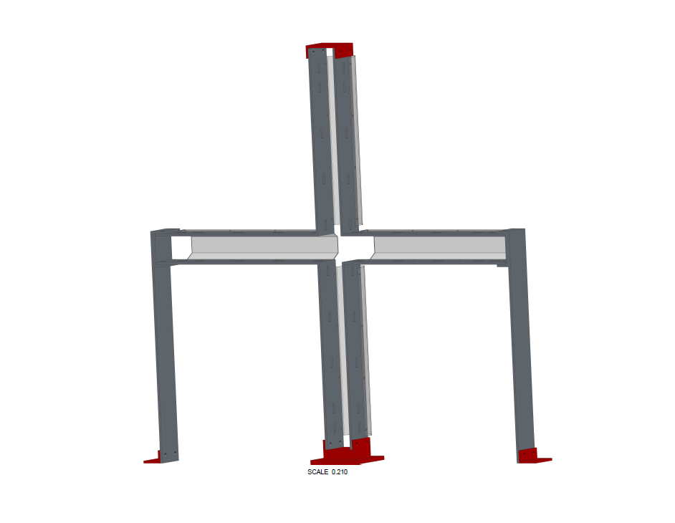
Design Concepts – Structure
Design B (Fabricated Al)

Slide 38
House of Quality
Customer Requirements | Customer Importance | Engineering Charateristics
 |  | Structural Thickness | Material Used | Locking Mechanism | Axis Adjustability | Mounting Mechansim | Base size | Height Above Ground | Number of Crossbeams | Weight
Increased Stability | 5 | 9 | 3 | 6 |  | 3 | 9 | 6 | 6
Lower Weight | 5 | 3 | 9 |  |  |  | 6 | 3 | 6 | 9
Good Images | 5 |  |  | 6 | 9 | 9 |  | 3
Better Horn Mounting | 5 |  |  | 9 | 9 | 9
Cost | 4 | 3 | 6 | 3 |  | 3 | 3 |  | 3
Hardware Box | 2 | 3 | 6 |  |  |  |  |  |  | 3
Portability | 2 |  | 6 |  |  |  | 9 | 6 |  | 9
Score |  | 18 | 30 | 24 | 18 | 24 | 27 | 18 | 15 | 21
Relative Weight |  | 78 | 108 | 117 | 90 | 117 | 105 | 72 | 72 | 69
Rank |  | 6 | 3 | 1 | 5 | 1 | 4 | 7 | 7 | 9

